Slide 1
The Third Option
Anger

Slide 2
The Third Option
Anger
Anger is a feeling, and feelings are neither right nor wrong.
2

Slide 3
The Third Option
Anger
Anger is a feeling, and feelings are neither right nor wrong.
Angry feelings are okay, normal, & human. We all have them.
3

Slide 4
The Third Option
Anger
Anger is a feeling, and feelings are neither right nor wrong.
Angry feelings are okay, normal, & human. We all have them.
How we handle our anger can be wrong and can get us into trouble.
4

Slide 5
The Third Option
“Angry feelings are OK. Angry behavior may NOT BE.”
5

Slide 6
Out of Balance
_____________________________________________
Stuff
6

Slide 7
The Third Option
Anger
The Stuffer
Approach: Denies or ignores
7

Slide 8
The Third Option
Anger
The Stuffer
Approach: Denies or ignores
Unhealthy impact on marriage
8

Slide 9
The Third Option
Anger
The Stuffer
Approach: Denies or ignores
Unhealthy impact on marriage
Analogy – an energy; a very powerful force – “Radioactive” – long half-life
9

Slide 10

The Third Option
10

Slide 11
Out of Balance
________________________________________________
Attack
11

Slide 12
The Third Option
Anger
The Attacker
Approach: Vents
12

Slide 13
The Third Option
Anger
The Attacker
Approach: Vents
Analogy – an atomic bomb
13

Slide 14
The Third Option
Anger
The Attacker
Approach: Vents
Analogy – an atomic bomb
Unhealthy impact on marriage
14

Slide 15
The Third Option
Anger
The Attacker
Approach: Vents
Analogy – an atomic bomb
Unhealthy impact on marriage
We fear anger which is out of control
15

Slide 16
The Third Option
Anger
The Attacker
Approach: Vents
Analogy – an atomic bomb
Unhealthy impact on marriage
We fear anger which is out of control
We can be both
16

Slide 17
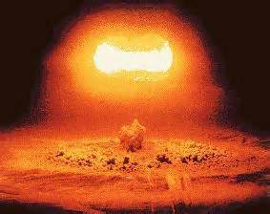
The Third Option
17

Slide 18
Solution
The Third Option - Balance
_____________________________________________
Stuff Attack
Channel
18

Slide 19
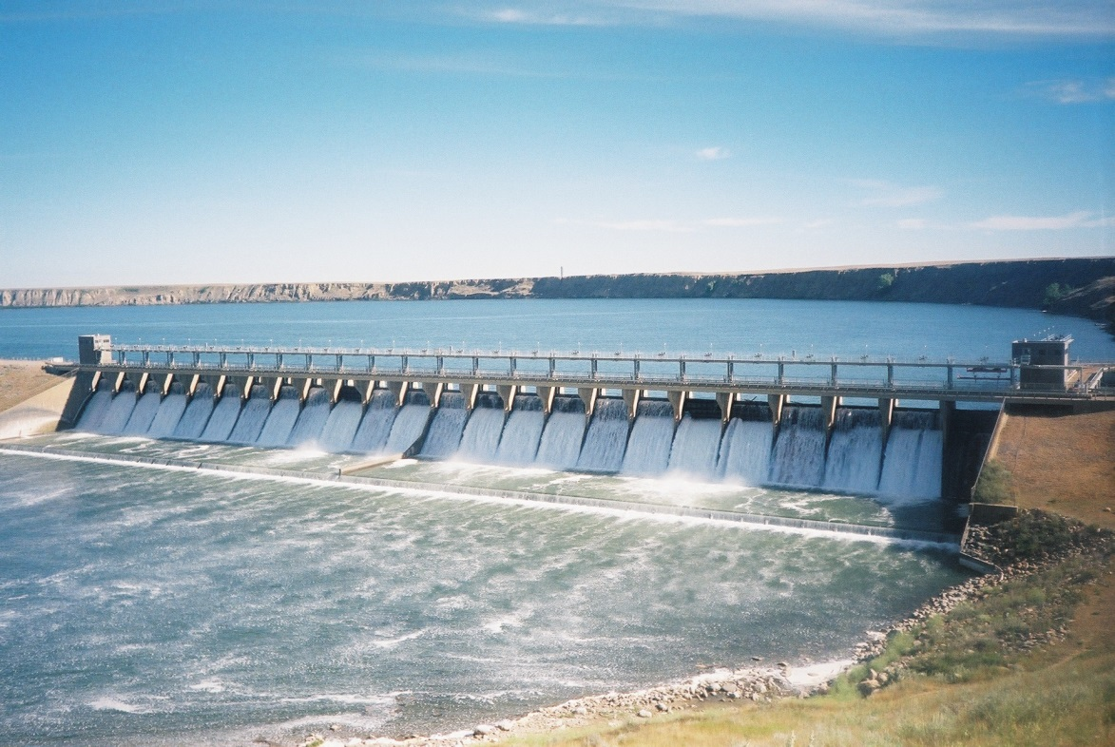
The Third Option
19

Slide 20
The Third Option
Solution: C.U.T.T.
Control it
20

Slide 21
The Third Option
C.U.T.T.
Control it
Monitor “Early Warning Signs”
21

Slide 22
The Third Option
C.U.T.T.
Control it
Monitor “Early Warning Signs”
“Count to ten” – Deep Breath, Remain Calm
22

Slide 23
The Third Option
C.U.T.T.
Control it
Monitor “Early Warning Signs”
“Count to ten” – Deep Breath, Remain Calm
Time Out – with commitment to return to the issue
23

Slide 24
The Third Option
Solution: C.U.T.T.
Control it
Use up the energy
24

Slide 25
The Third Option
C.U.T.T.
Use up the energy
Exercise (constructive)
25

Slide 26
The Third Option
C.U.T.T.
Use up the energy
Exercise (constructive)
Give yourself permission to cry
26

Slide 27
The Third Option
C.U.T.T.
Use up the energy
Exercise (constructive)
Give yourself permission to cry
Write about it – to yourself / to God
27

Slide 28
The Third Option
Solution: C.U.T.T.
Control it
Use up the energy
Think about it
28

Slide 29
The Third Option
C.U.T.T.
Think about it
Is this really anger?
29

Slide 30
The Third Option
C.U.T.T.
Think about it
Is this really anger?
Is it really about this – “here”?
30

Slide 31
The Third Option
C.U.T.T.
Think about it
Is this really anger?
Is it really about this – “here”?
Why am I so angry?
31

Slide 32
The Third Option
C.U.T.T.
Think about it
Is this really anger?
Is it really about this – “here”?
Why am I so angry?
Want my own way
32

Slide 33
The Third Option
C.U.T.T.
Think about it
Is this really anger?
Is it really about this – “here”?
Why am I so angry?
Want my own way
Not being respected
33

Slide 34
The Third Option
Solution: C.U.T.T.
Control it
Use up the energy
Think about it
Talk (and listen) about it
34

Slide 35
The Third Option
C.U.T.T.
Talk (and listen) about it
Take time for both to calm down
35

Slide 36
The Third Option
C.U.T.T.
Talk (and listen) about it
Take time for both to calm down
Use “I Statements” – Do not blame!
36

Slide 37
The Third Option
C.U.T.T.
Talk (and listen) about it
Take time for both to calm down
Use “I Statements” – Do not blame!
Calmly talk – and listen
37

Slide 38
The Third Option
No one “makes us angry”
My anger is my problem.
Your anger is your problem.
38

Slide 39
The Third Option
“Anger is in the eyes of the beholder.”
“Anger is like PAIN - it’s telling us something.”
“Angry feelings are OK. Angry behavior may NOT BE.”
39

