Slide 1
The Third Option
Childhood Issues

Slide 2
The Third Option
Childhood Issues
Why does someone act the way they do?
2

Slide 3
The Third Option
Childhood Issues
Why does someone act the way they do?
We don’t understand our spouse’s history (or our own)
3

Slide 4
The Third Option
Childhood Issues
Messages from our family
Messages we received
Role models
Our place/role in the family
Who was missing?
4

Slide 5
The Third Option
Childhood Issues
Messages from our family
Messages we received
Role models
Our place/role in the family
Who was missing?
What does it teach us?
5

Slide 6
Out of Balance
_____________________________________________
Denial
6

Slide 7
Out of Balance
________________________________________________
Fatalism
7

Slide 8
Solution
The Third Option - Balance
_____________________________________________
Denial Fatalism
Sort them out
8

Slide 9
Solution
The Third Option - Balance
_____________________________________________
Denial Fatalism
Sort them out
Keep the positive and
let go of the negative
9

Slide 10
The Third Option
Knapsack
Leftover emotions from early years is Emotional Baggage
10

Slide 11
The Third Option
Solution:
Emotional Baggage
Anger/Rage
11

Slide 12
The Third Option
Solution:
Emotional Baggage
Anger/Rage
Fear/Panic/Anxiety
12

Slide 13
The Third Option
Solution:
Emotional Baggage
Anger/Rage
Fear/Panic/Anxiety
Resentment/Bitterness
13

Slide 14
The Third Option
Solution:
Emotional Baggage
Anger/Rage
Fear/Panic/Anxiety
Resentment/Bitterness
Guilt/Shame/Inferiority
14

Slide 15
The Third Option
Solution:
Emotional Baggage
Anger/Rage
Fear/Panic/Anxiety
Resentment/Bitterness
Guilt/Shame/Inferiority
Hurt/Pain
15

Slide 16
The Third Option
Solution:
Emotional Baggage
Anger/Rage
Fear/Panic/Anxiety
Resentment/Bitterness
Guilt/Shame/Inferiority
Hurt/Pain
Depression
16

Slide 17
The Third Option
Solution:
Discover Your/Their
Emotional Baggage
17

Slide 18
The Third Option
Solution:
Our life’s work is to get our
emotional needs met
18

Slide 19
The Third Option
Solution:
Our life’s work is to get our
emotional needs met
The deficiencies of childhood become the unfinished business of adulthood
19

Slide 20
The Third Option
Solution:
Unfinished Business
20

Slide 21
The Third Option
Solution:
Unfinished Business
The need to be heard/listened to/understood/paid attention to
21

Slide 22
The Third Option
Solution:
Unfinished Business
The need to be heard/listened to/understood/paid attention to
The need to be touched/held/hugged
22

Slide 23
The Third Option
Solution:
Unfinished Business
The need to be heard/listened to/understood/paid attention to
The need to be touched/held/hugged
The need for unconditional love/acceptance for who we are
23

Slide 24
The Third Option
Solution:
Unfinished Business
The need to be heard/listened to/understood/paid attention to
The need to be touched/held/hugged
The need for unconditional love/acceptance for who we are
The need for autonomy/independence/separateness
24

Slide 25
The Third Option
Solution:
Unfinished Business
The need to be heard/listened to/understood/paid attention to
The need to be touched/held/hugged
The need for unconditional love/acceptance for who we are
The need for autonomy/independence/separateness
The need for significance/importance/competence
25

Slide 26
The Third Option
Solution:
Unfinished Business
The need to be heard/listened to/understood/paid attention to
The need to be touched/held/hugged
The need for unconditional love/acceptance for who we are
The need for autonomy/independence/separateness
The need for significance/importance/competence
The need to intimate/known/connected/to belong
26

Slide 27
The Third Option
Solution:
Discover your own
and your partner’s
Unfinished Business
27

Slide 28
The Third Option
Childhood Issues
Complications:
High risk factors
Pursuer-Distancer
28

Slide 29
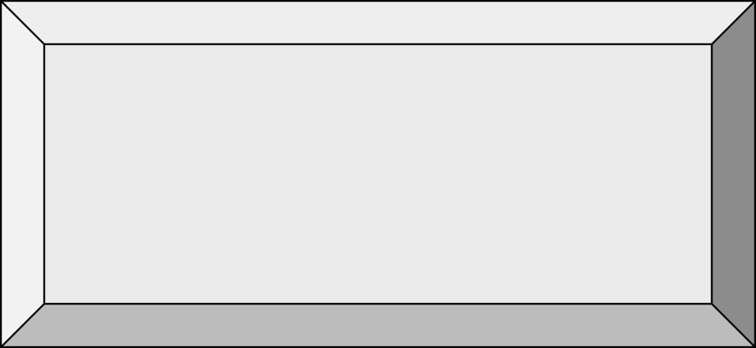

The Third Option
Let’s have a
Garage Sale
29

