Slide 1
The Third Option
Feelings / Hurt

Slide 2
The Third Option
We have a tendency of Fight or Flight when we are hurt.
2

Slide 3
The Third Option
We have a tendency of Fight or Flight when we are hurt.
They are self-defence or survival instincts.
3

Slide 4
The Third Option
We have a tendency of Fight or Flight when we are hurt.
They are self-defence or survival instincts.
Neither works well in marriage.
4

Slide 5
Out of Balance
_____________________________________________
Come out roaring
5

Slide 6
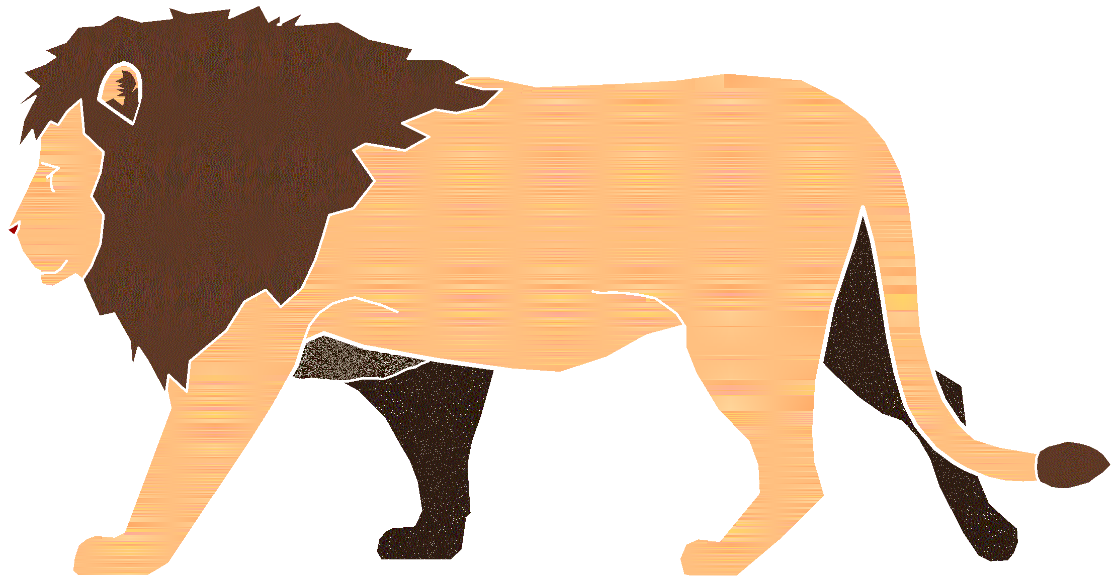
The Third Option
6

Slide 7
Out of Balance
________________________________________________
Go into our shell
7

Slide 8
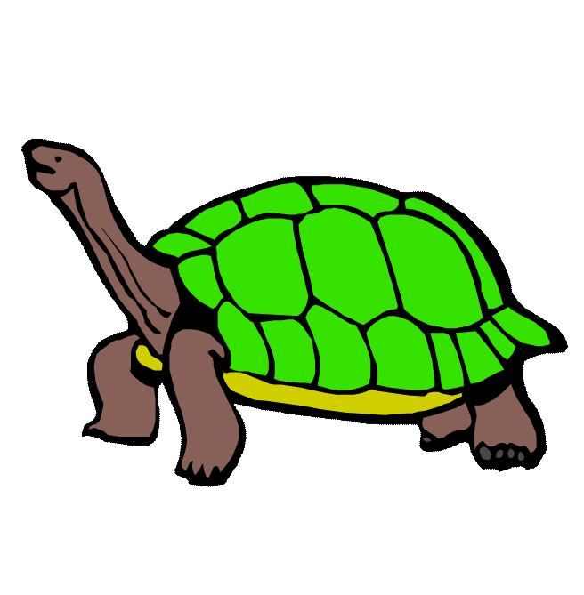
The Third Option
8

Slide 9
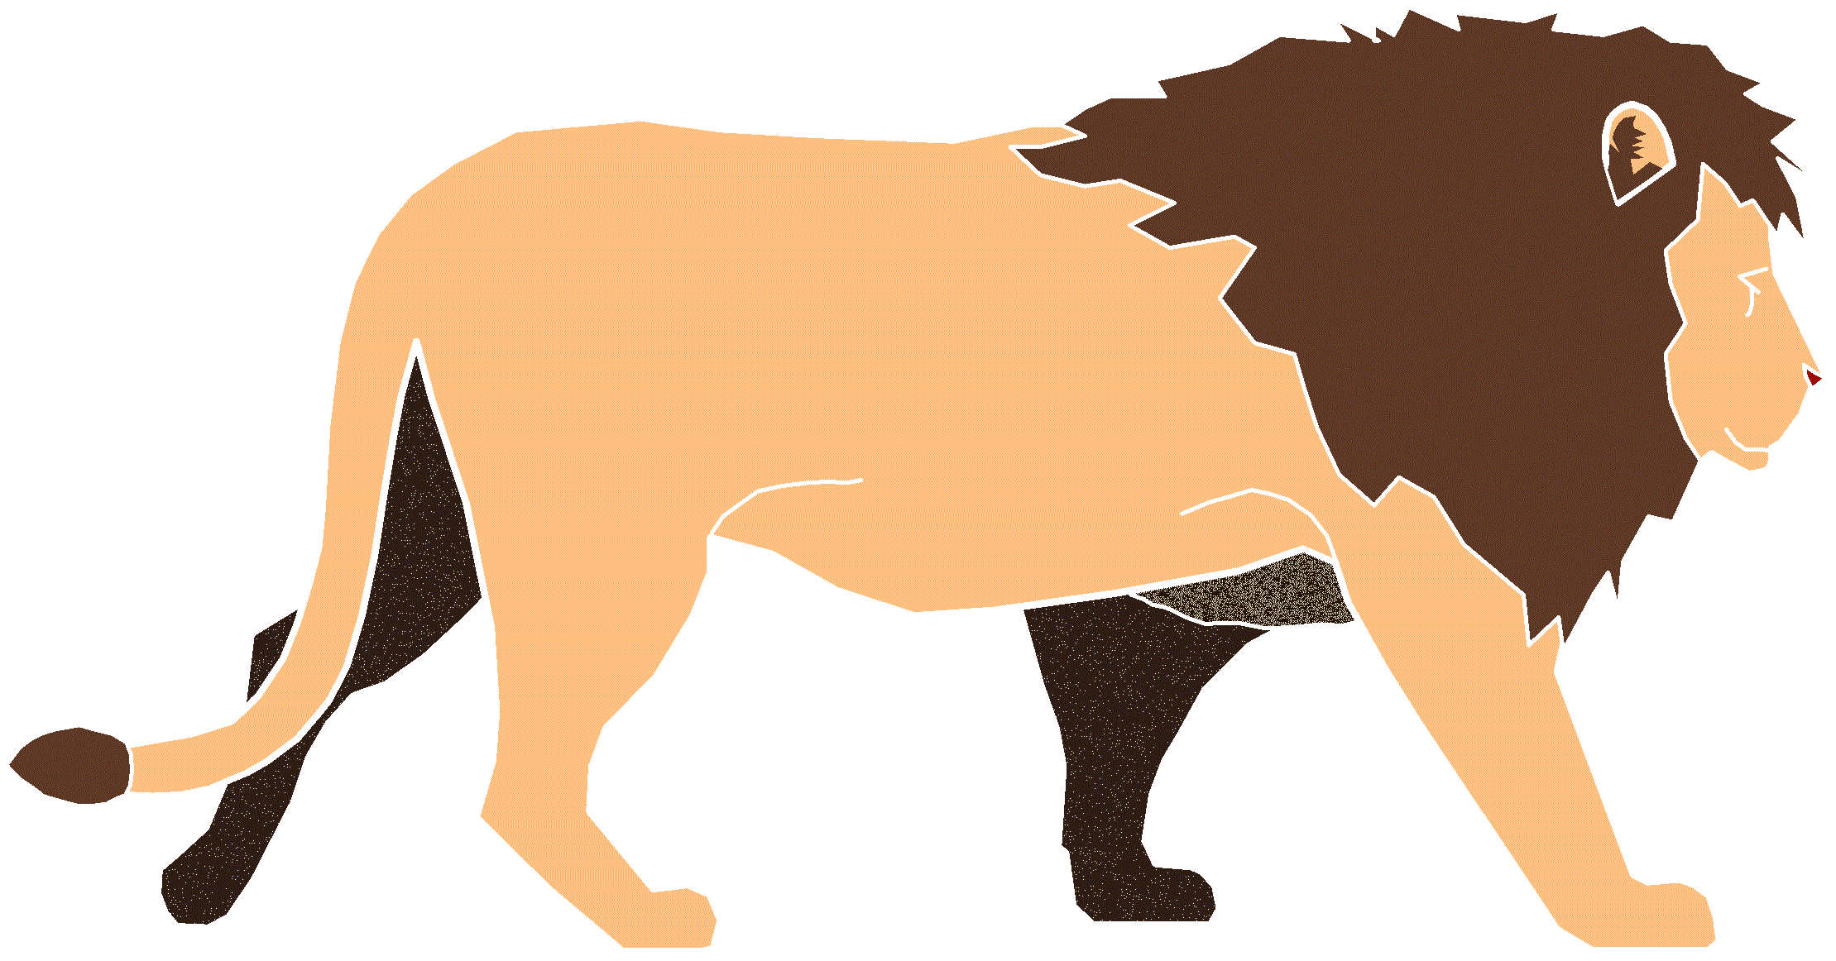
The Third Option
Which do you tend to be?
9

Slide 10
The Third Option
Solutions for the Turtle:
Stick Your Neck Out
10

Slide 11
The Third Option
Solutions for the Turtle:
Stick Your Neck Out
Speak When Safe
11

Slide 12
The Third Option
Solutions for the Lion:
Stop Roaring!
12

Slide 13
The Third Option
Solutions for the Lion:
Stop Roaring!
Become Soft
13

Slide 14
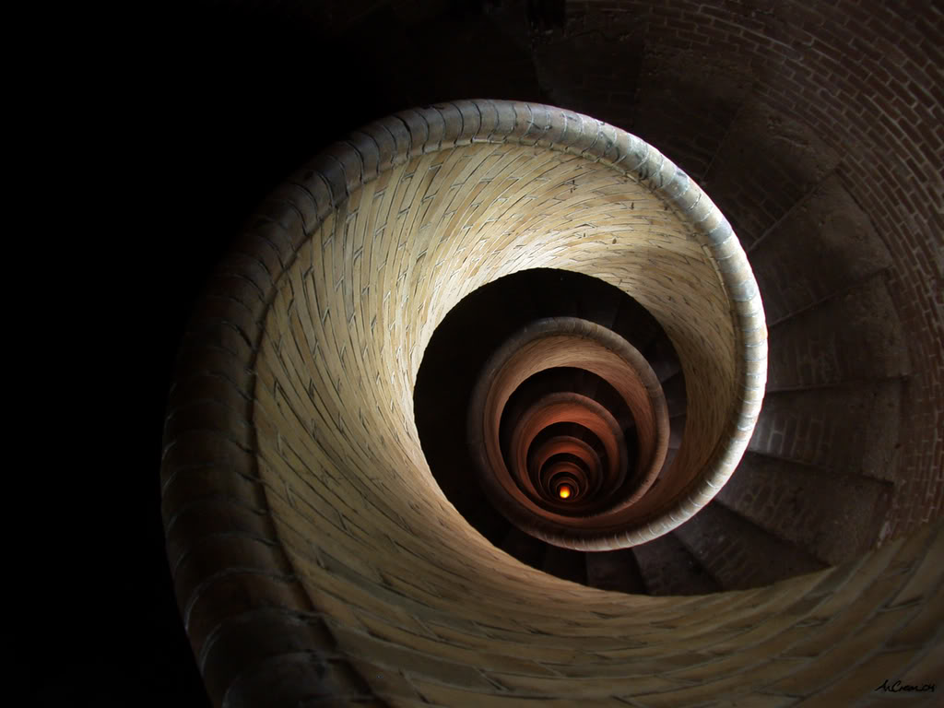
The Third Option
The Hurt Spiral
14

Slide 15
The Third Option
The Hurt Spiral
We react emotionally –
“Hurt back” – “Get even”
15

Slide 16
The Third Option
The Hurt Spiral
We react emotionally –
“Hurt back” – “Get even”
Creates a Downward Spiral –
Rationalize/justify behavior
16

Slide 17
The Third Option
The Hurt Spiral
We react emotionally –
“Hurt back” – “Get even”
Creates a Downward Spiral –
Rationalize/justify behavior
Extremely Dangerous!
17

Slide 18
The Third Option
The Hurt Spiral
More and more hurtful behavior is justified and inflicted.
18

Slide 19
The Third Option
The Hurt Spiral
More and more hurtful behavior is justified and inflicted.
The relationship becomes more and more out of control…
19

Slide 20
The Third Option
The Hurt Spiral
More and more hurtful behavior is justified and inflicted.
The relationship becomes more and more out of control…
until it can eventually be destroyed
20

Slide 21
The Third Option
STOP RETALIATING!
21

Slide 22
The Third Option
The Hurt Spiral
What NOT to do during the Hurt Spiral
22

Slide 23
The Third Option
The Hurt Spiral
What NOT to do during the Hurt Spiral
Ignore it and pretend we’re not hurt
23

Slide 24
The Third Option
The Hurt Spiral
What NOT to do during the Hurt Spiral
Ignore it and pretend we’re not hurt
Continue to hurt back
24

Slide 25
The Third Option
The Hurt Spiral
What NOT to do during the Hurt Spiral
Ignore it and pretend we’re not hurt
Continue to hurt back
Allow ourselves to be hurt
25

Slide 26
The Third Option
Solutions
Instead, we should…
26

Slide 27
The Third Option
Solutions
Remember – the first hurt is NOT intentional.
27

Slide 28
The Third Option
Solutions
Remember – the first hurt is NOT intentional
First say “OUCH”
28

Slide 29
The Third Option
Solutions
Remember – the first hurt is NOT intentional
First say “OUCH”
Talk Backwards
29

Slide 30
The Third Option
Solutions
Remember – the first hurt is NOT intentional
First say “OUCH”
Talk Backwards
“Peel the Onion”
30

Slide 31
The Third Option
“Open Dialogue,
Not War.”
31

Slide 32
Solution
The Third Option - Balance
_____________________________________________
Come out roaring Go into our shell
Dialogue
32

Slide 33
The Third Option
“Am I building up
or tearing down?”
33

